Slide 1
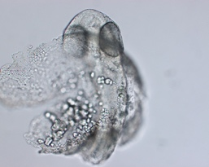
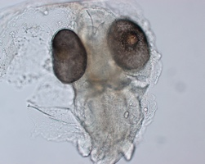
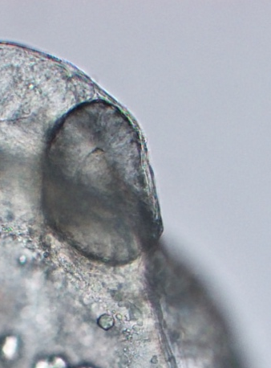
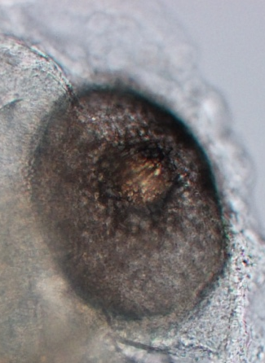
A
B
A’
B’
B’
Zebrafish_29hpf
Medaka_72 hpf
Figure 3.1 Morphology of zebrafish embryo at 29 hpf and medaka embryo at 72 hpf.
A’ and B’ show magnified images of rectangle area in A, B, respectively. Scale bars = 100 µm in A, B and 50 µm in A’, B’.

Slide 2
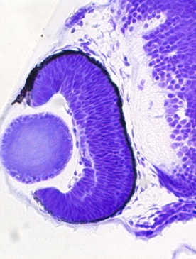
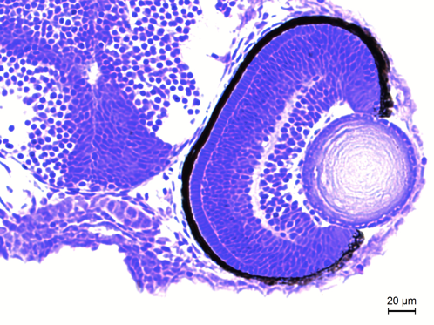
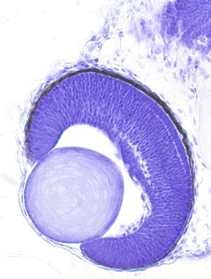
A
B
C
Zebrafish
39 hpf
Zebrafish 49 hpf
Zebrafish 60 hpf
D
Medaka (HdrR) 72 hpf (St.28)
Figure 3.2 Histological sections of zebrafish and medaka embryo.
Resin-imbedded embryos were sectioned at 8 µm thickness and Nissl stained. Zebrafish embryo at 39 (A), 49 (B), and 60 (C) hpf and medaka embryo at 72 hpf (St. 28, D) are shown. Layered structure of retina do not develop in 39 hpf zebrafish embryo. Scale bars = 20 µm.

Slide 3
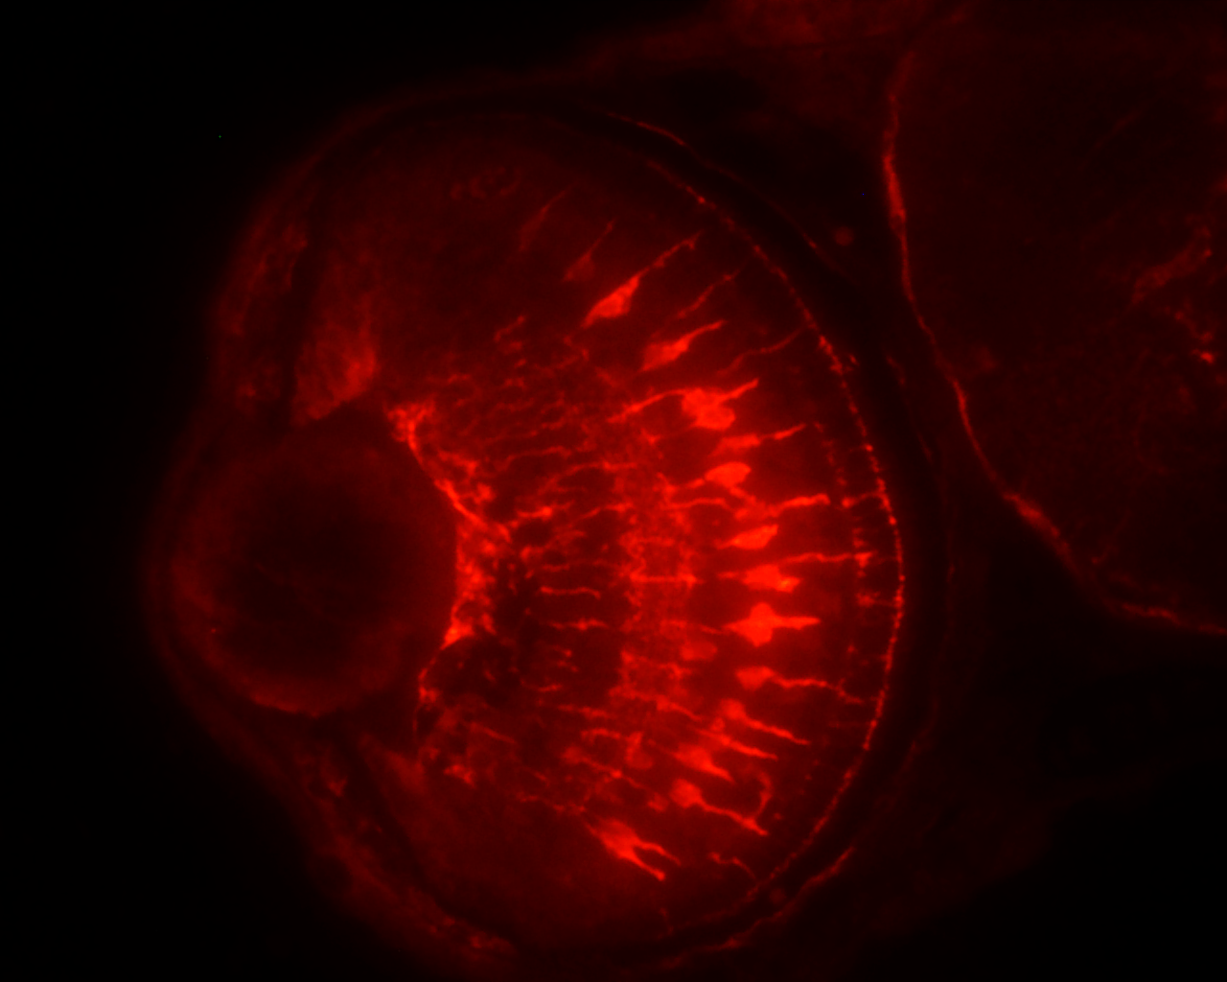
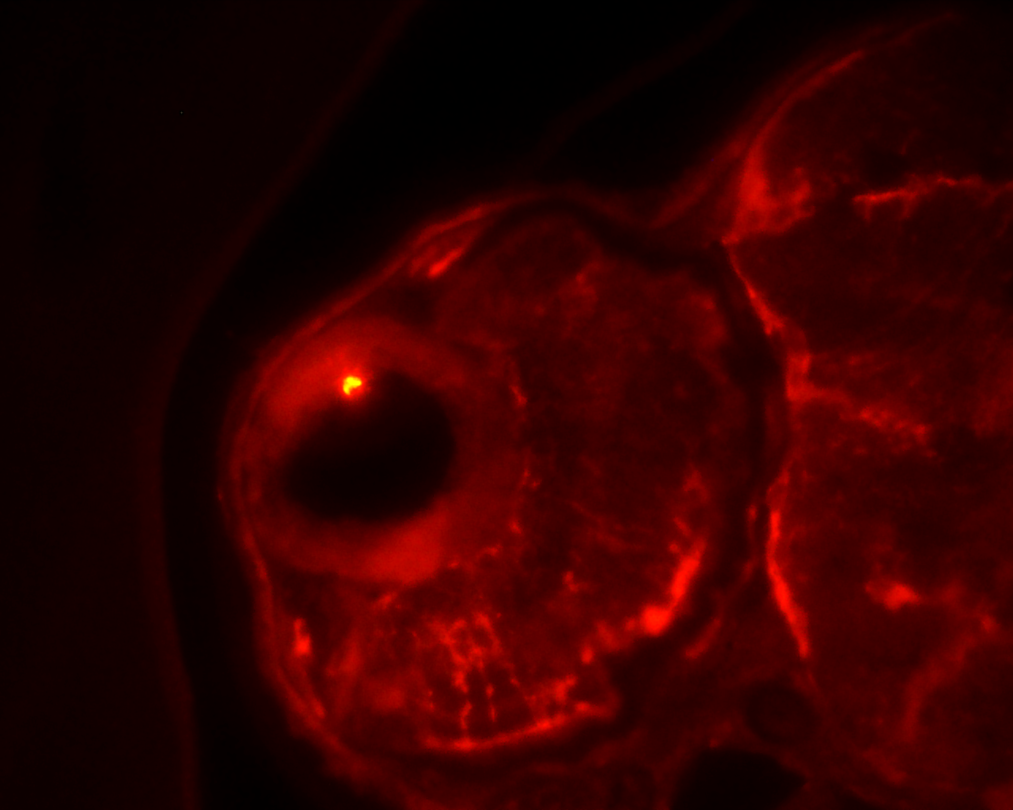
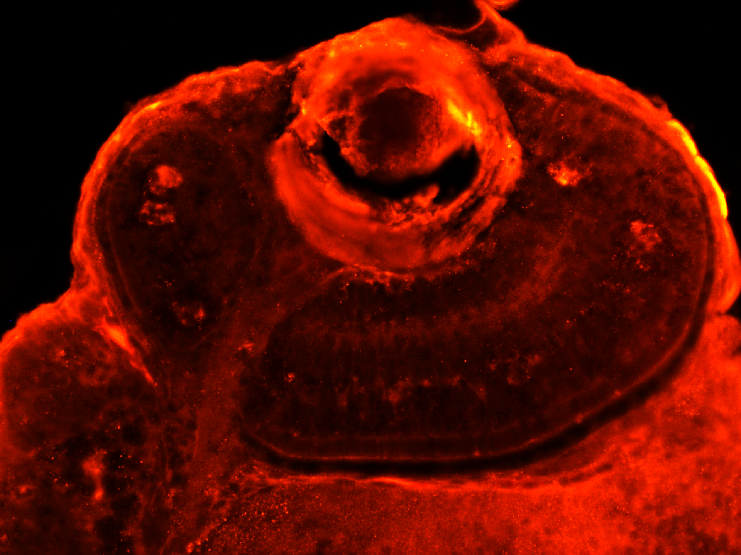
Zebrafish_72 hpf
Medaka_96 hpf
GS (Müller glia)
A
GS (Müller glia)
C
Control
GS (Müller glia)
B
GS (Müller glia)
D
50 hpi_10 Gy
Figure 3.3 Müller glia development in zebrafish and medaka embryo.
Zebrafish embryo at 72 hpf (A) and medaka embryo at 96 hpf (C) were immuno-stained with anti-Glutamine synthetase (GS) antibody, which is widely used to localize Müller glia(white arrows). Zebrafish embryo at 22 hours after the irradiation at 50 hpf (B) and medaka embryo 24 hours after the irradiated at 96 hpf (D) were also immuno-stained with anti-GS antibody. Scale bars = 50 µm.

Slide 4
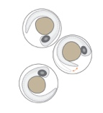


Irradiation at 29 hpf
Irradiation at 50 hpf
72 hpf =22 hpi
Nissl staining → Confirmation of damage
Zebrafish embryo
1
2
3
0
(days)
53 hpf = 24 hpi
Nissl staining → Confirmation of damage
Figure 3.4 Time scheme of the irradiation experiments.

Slide 5
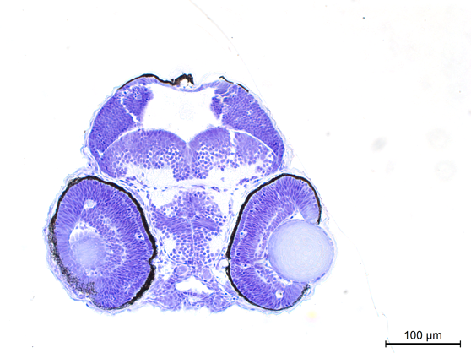
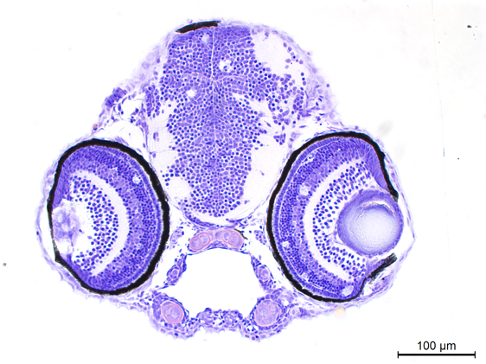
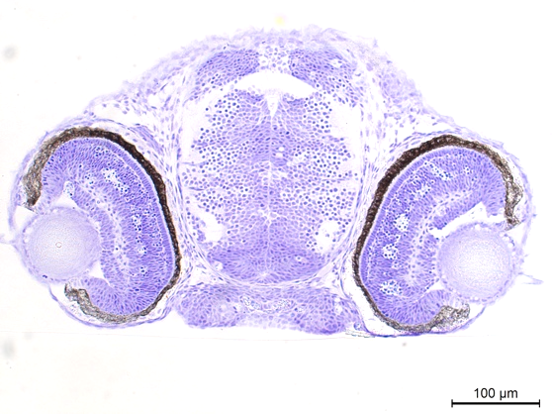
Zebrafish
24 hours after irradiation (10 Gy) of 29 hpf embryo
22 hours after irradiation (10 Gy) of 50 hpf embryo
A
B
Medaka (HdrR)
24 hours after irradiation (10 Gy) of 3 dpf (st.28) embryo
C
Figure 3.5 Apoptosis induced at 24 hours after irradiation in zebrafish and medaka embryos.
Zebrafish embryos at 29 (A) and 50 hpf (B) were irradiated with 10 Gy of gamma-rays and histological sections were prepared 24 hours after the irradiation and Nissl-stained. Medaka embryos at 96 hpf were irradiated with 10 Gy of gamma-rays and histological sections were prepared 24 hours after the irradiation and Nissl-stained (C). Scale bars = 100 µm.

Slide 6
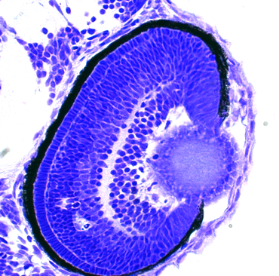
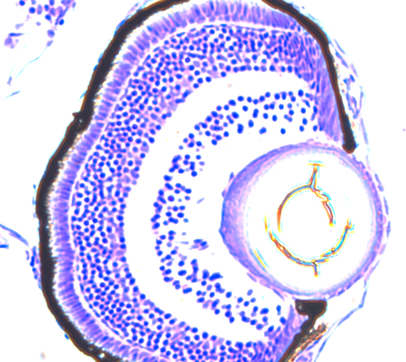
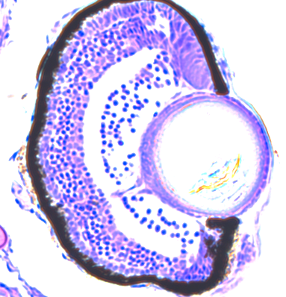
Control
50hpf_10Gy
ONL
A
D
INL
GCL
GCL
INL
60 hpf
ONL
10 hpi (60 hpf)
INL
B
E
ONL
GCL
GCL
72 hpf
INL
22 hpi (72 hpf)
ONL
C
F
ONL
ONL
INL
GCL
INL
96 hpf
GCL
48 hpi (96 hpf)
: apoptotic cell death
Figure 3.6 Time course of apoptosis induction in retina of zebrafish embryo.
Zebrafish embryos at 50 hpf were irradiated with 10 Gy if gamma-rays and histological sections were prepared at 10 hpi (D), 22 hpi (E) and 48 hpi (F) and Nissl-stained. Apoptotic cell death (magenta arrows) were present mainly in the INL of the retinas of the 10 and 22 hpi embryos. There was no apoptotic cells in the 48 hpi embryos and non-irradiated embryos (A, B, C). Scale bars = 50 µm.

